Slide 1
SAN and DAS -
Concepts and Applications
Storing Smarter, Not Harder: Navigating the Seas of SAN and DAS

Slide 2
Understanding SAN and DAS
Brief introduction to Storage Area Network (SAN) and Direct-Attached Storage (DAS).
Objectives:
Understand the basic concepts of SAN and DAS.
Explore the applications and use-cases of SAN and DAS in modern IT infrastructure.
Compare and contrast SAN and DAS.

Slide 3
Primer
Before we can discuss SAN and DAS we need to review the mechanics and other storage types.

Slide 4
Character Devices vs. Block Devices
Character Devices: Transmit data character by character. Ideal for keyboards, mice, or any device that sends/receives a single character at a time.
Block Devices: Store data in fixed-size blocks. Hard drives and SSDs are typical examples, with data managed in blocks, allowing random access.

Slide 5
File Storage: Keeping it Familiar
Definition: Hierarchical storage method, organizing data in files and folders.
Characteristics: Easy to understand and navigate, with data accessed through file names and paths.
Common Use-Cases: Everyday computing, document storage, and traditional databases.

Slide 6
Block Storage: Beyond the Basics
Definition: Stores data in uniform blocks or volumes.
Characteristics: High performance, low latency, and flexibility. Ideal for database storage, VM file systems.

Slide 7
Block Storage - The Anatomy of Data Organization
Blocks - The Fundamental Units: Each block in block storage acts as an individual hard drive, storing a fixed size of data. Blocks are addressable by a unique identifier, allowing for efficient data retrieval.
Block Sizes - Balancing Performance and Space: Block size determines how data is divided. Larger blocks can improve performance for sequential data access but may lead to wasted space, known as slack space, when storing small files.

Slide 8
Clusters and Cylinders - Optimizing Data Access
Clusters - Grouping Blocks: A cluster is a group of contiguous blocks, acting as the smallest unit of disk space that can be allocated to a file. The cluster size affects the disk's storage efficiency and performance.
Cylinders - HDD Organization: In traditional HDDs, a cylinder comprises tracks located at the same position on different platters. Understanding cylinders helps in optimizing data access in these devices, though it's less relevant in modern SSDs.

Slide 9
Cluster and Block sizes: Impact on Read/Write Operations
Block Size Alignment with Data Size:
If the block size is well-aligned with the size of the data being read or written, data transfer can be more efficient because each read/write operation corresponds closely to the block size.
Misalignment (e.g., a file size smaller than the block size) can lead to increased overhead and decreased performance due to the need to read or write entire blocks even for small amounts of data.

Slide 10
Cluster and Block sizes: Impact on Read/Write Operations
Block Size Alignment with Data Size:
If the block size is well-aligned with the size of the data being read or written, data transfer can be more efficient because each read/write operation corresponds closely to the block size.
Misalignment (e.g., a file size smaller than the block size) can lead to increased overhead and decreased performance due to the need to read or write entire blocks even for small amounts of data.

Slide 11
Cluster and Block sizes: Impact on Read/Write Operations
I/O Operation Efficiency:
Larger blocks mean that fewer I/O operations are needed to read or write a large file, potentially improving performance for tasks that involve large, sequential data transfers.
Conversely, for workloads that involve numerous small, random access read/write operations, smaller block sizes might improve performance since less unnecessary data is read or written.

Slide 12
Impact on Disk Space Utilization: Slack Space Consideration
Slack Space Consideration:
With larger block sizes, there's typically more slack space because the remaining part of the block remains unused if the file size doesn't exactly fill the block. This can lead to wasted disk space, especially if the storage system contains a large number of small files.
Smaller block sizes can minimize slack space and optimize disk space utilization. However, this might increase the metadata overhead (more blocks to manage) and potentially reduce performance due to increased fragmentation.
Cluster Size and Allocation:
The cluster size (group of blocks) also impacts disk space utilization. Larger clusters can lead to more slack space but reduce the filesystem's metadata since fewer clusters need to be managed.
Choosing the right cluster size is a balance between optimizing disk space usage and maintaining an efficient and fast file system.

Slide 13
Impact on Disk Space Utilization: Cluster Size and Allocation
The cluster size (group of blocks) also impacts disk space utilization. Larger clusters can lead to more slack space but reduce the filesystem's metadata since fewer clusters need to be managed.
Choosing the right cluster size is a balance between optimizing disk space usage and maintaining an efficient and fast file system.

Slide 14
Considerations for Specific Storage Media
HDDs vs. SSDs:
For HDDs, larger blocks and clusters can reduce the mechanical movement of the read/write head, improving performance.
In SSDs, which have no moving parts and faster access times, the impact of block and cluster sizes on performance might be less pronounced. However, wear leveling and block erase considerations are essential for SSDs.

Slide 15
Object Storage - A New Approach to Scalability
Definition: Stores data as objects, each containing the data, metadata, and a unique identifier.
Characteristics: Highly scalable, location-independent, and suitable for unstructured data.
Common Use-Cases: Big data analytics, cloud-native applications, and backup storage.

Slide 16
Review! Sector vs Block
Sector:
The smallest unit of data storage on a hard disk.
A sector typically stores a fixed amount of data, traditionally 512 bytes, but newer hard drives might use 4K sectors.
Sectors are sequentially numbered within a track.
Block:
Often used interchangeably with "sector" but can also refer to a group of sectors.
In filesystems, a "block" typically represents the smallest unit of data that the operating system can read or write. In this context, a block might consist of multiple sectors.
The term "block" is more commonly used in the context of filesystems or higher-level storage abstractions, whereas "sector" is more of a physical disk-level term.

Slide 17
Review! Cylinder
Cylinder:
Refers to a set of tracks that are at the same position on each platter of a hard disk. When the read/write heads move across the platters, they access the same track number on each platter, which collectively forms a cylinder.
The concept of cylinders is important in the context of older HDDs where the disk head had to physically move to the correct track. All the sectors that can be accessed without moving the head form a cylinder.
In modern computing, the importance of cylinders has diminished with advancements in storage technology and the use of Logical Block Addressing (LBA), which abstracts the physical geometry of the disk.

Slide 18
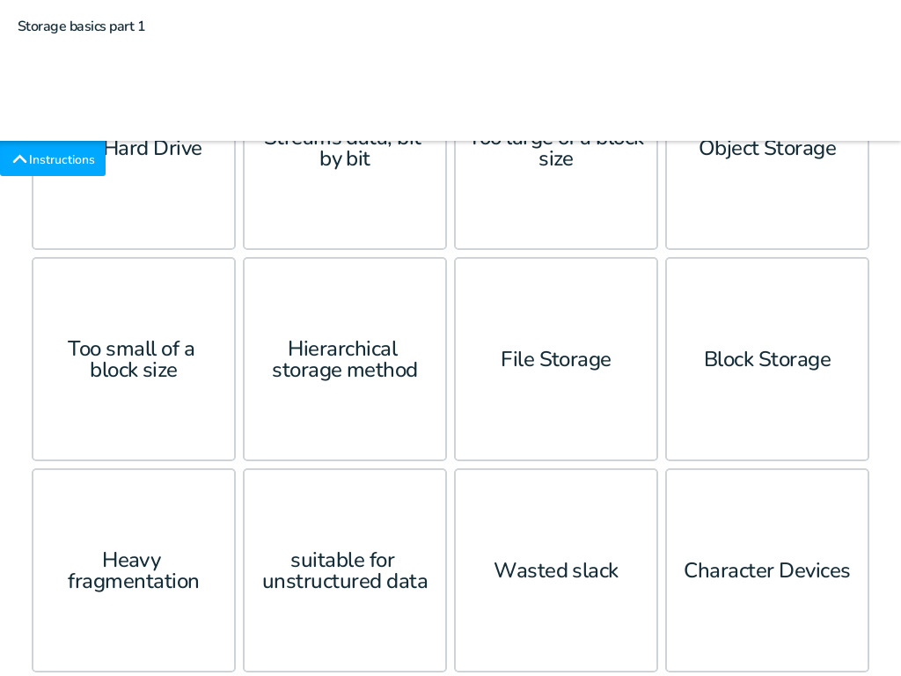
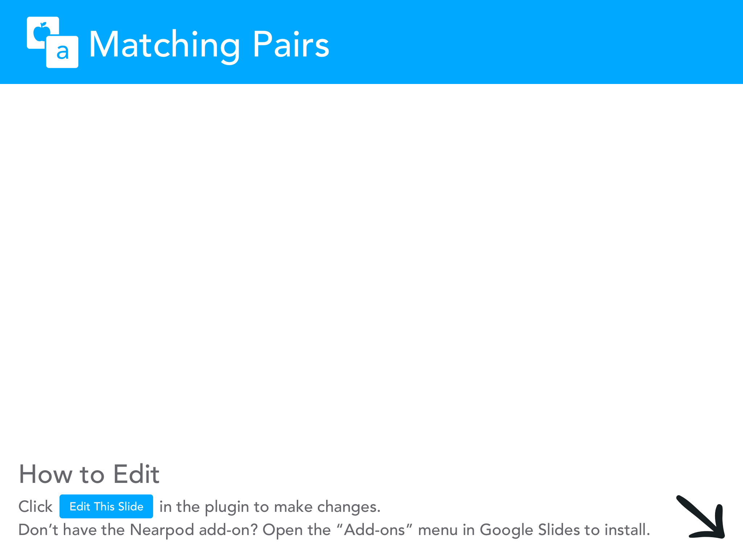

Slide 19
What is Direct-Attached Storage (DAS)?
Definition: DAS is a digital storage system directly attached to a server or workstation, without a network interface.
Characteristics:
Simplicity and cost-effectiveness.
Typically used for individual computers or small networks.
Common Use-Cases:
File storage for individual users.
Backup storage for small businesses.

Slide 20
Understanding Storage Area Network (SAN)
Definition: SAN is a high-speed network that interconnects and presents shared pools of storage devices to multiple servers.
Characteristics:
Scalability and flexibility in storage management.
High performance and reliability.
Common Use-Cases:
Centralized storage for large enterprises.
Support for critical applications requiring high availability and performance.

Slide 21
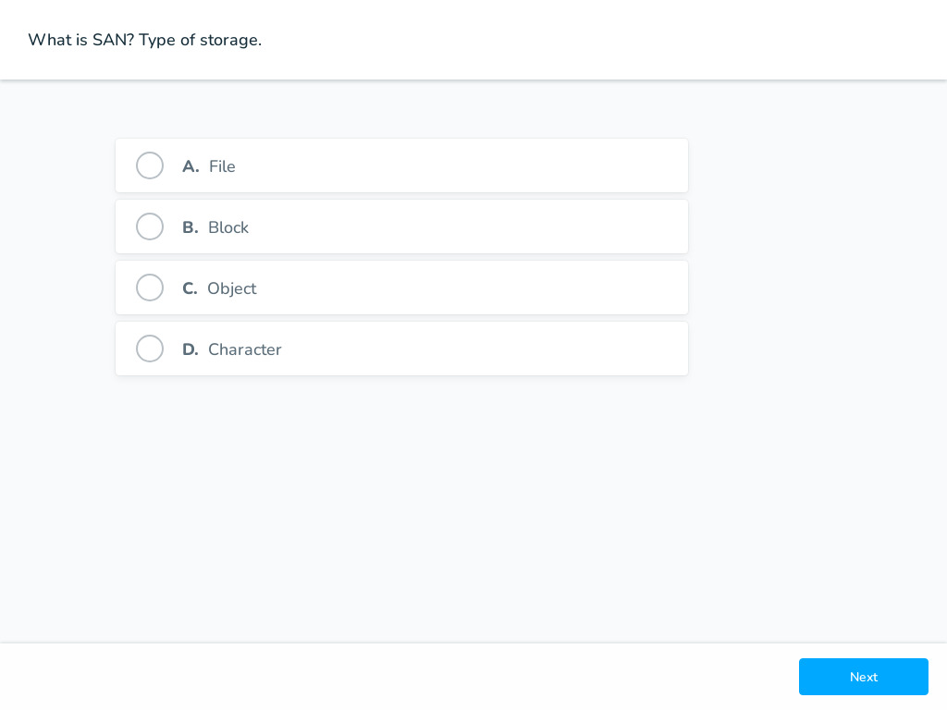


Slide 22
DAS vs. SAN: Key Differences
Compare DAS and SAN based on:
Connectivity: DAS is directly attached, while SAN is network-based.
Scalability: DAS has limited scalability, SAN offers extensive scalability.
Performance: SAN typically offers higher performance, especially in larger environments.
Cost Implication: DAS is generally more cost-effective for smaller setups, SAN involves higher initial investment but offers long-term benefits for larger setups.

Slide 23



Slide 24
Understanding Thin Provisioning
Definition: Thin provisioning is a method of optimizing and managing storage where physical storage capacity is allocated on demand. This approach allows for the allocation of more storage capacity to applications or users than is physically available.
Contrast with Traditional Storage: In traditional (thick) provisioning, physical storage is fully allocated when a volume is created, leading to potential underutilization. Thin provisioning, by contrast, allocates storage based on actual usage, enhancing efficiency.

Slide 25
Maximizing Storage with Thin Provisioning in SANs
Efficient Storage Utilization:
Thin provisioning in SANs enhances storage utilization by dynamically allocating space based on actual data usage. This method eliminates the wasted space commonly seen in traditional provisioning, where physical storage is allocated but often underutilized.
Cost-Effective Scaling:
By allowing on-demand allocation of storage, thin provisioning defers the need for upfront purchase of physical storage. This delay in capital expenditure makes it a cost-effective solution for scaling storage infrastructure as the actual data grows.
Flexibility and Agility:
Offers IT administrators the ability to manage storage resources flexibly, adapting quickly to changing needs without the risk of over-provisioning. This agility ensures that storage capacity aligns closely with current demand, enhancing operational efficiency.

Slide 26
Implementing Thin Provisioning: Best Practices
Monitoring and Management:
Critical to regularly monitor storage usage and patterns to ensure that the physical storage can effectively support the volumes provisioned thinly. Proactive monitoring helps in anticipating needs and avoiding capacity shortages.
Integration with SAN Features:
Thin provisioning complements other SAN features like snapshots, replication, and data deduplication. When used together, these features contribute to an optimized, high-performance storage environment, maximizing the benefits of virtualized storage solutions.
Risk Mitigation:
While offering numerous benefits, thin provisioning requires careful management to mitigate risks such as over-provisioning. Ensuring adequate physical storage and employing predictive analysis tools can help in maintaining a balance between allocated and used storage, preventing potential resource exhaustion.

Slide 27
Snapshots: Technical Deep Dive
Snapshots function based on the 'copy-on-write' mechanism, where the system only copies data blocks when they are modified.
Initially, snapshots point to the same data blocks as the live system. They consume minimal space as no actual data is duplicated.
When a change occurs in the live data, the original block is copied to a new location before modification. The snapshot continues to point to the unmodified block, while the live system points to the modified one.
This process ensures that snapshots only consume additional space for data blocks that have changed since the snapshot was taken, aligning with the principles of thin provisioning by optimizing storage usage.

Slide 28
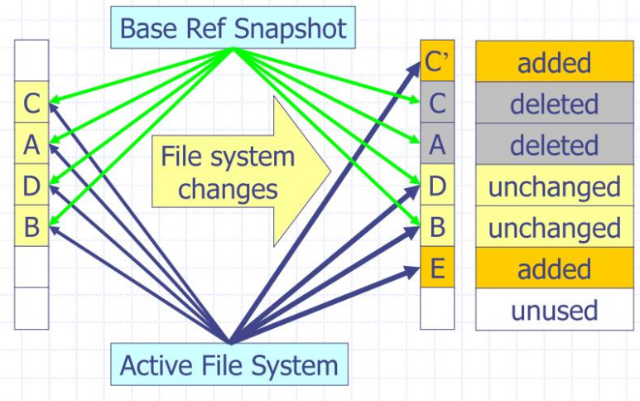
COW Snapshot
Source: SlideServe

Slide 29
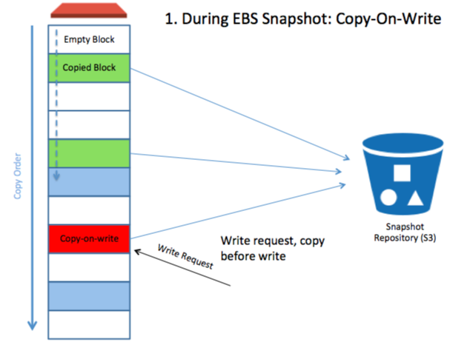
S3 Snapshots on AWS
Source: n2ws

Slide 30
Space Efficiency: Snapshots and Thin Provisioning
The synergy between snapshots and thin provisioning lies in their mutual focus on storage efficiency.
Thin provisioning allocates storage space dynamically, while snapshots ensure that only changes in data, not the entire dataset, consume additional space.
The 'copy-on-write' mechanism of snapshots complements thin provisioning by preventing unnecessary duplication of data, ensuring that space is used optimally and only as needed.
Understanding the dynamics of space usage in snapshots is crucial for storage planning and management, especially in systems where storage capacity and performance are critical considerations.

Slide 31
Best Practices for Snapshot Management
In a thinly provisioned environment, effective snapshot management is key to maintaining storage efficiency and performance.
Regularly monitor the growth of snapshots to ensure they do not consume more space than anticipated, which could lead to storage overprovisioning or performance bottlenecks.
Implement a strategic snapshot retention policy to balance the need for data protection with efficient storage utilization. Old snapshots should be pruned systematically to free up space while ensuring that critical data recovery points are retained.

Slide 32
Data Deduplication: Streamlining Storage
Data deduplication is a specialized data compression technique for eliminating duplicate copies of repeating data.
Enhances storage efficiency by storing only one unique instance of the data, regardless of how many times it occurs.
Operates at various levels – file level, block level, or even byte level, depending on the system and the deduplication method.

Slide 33
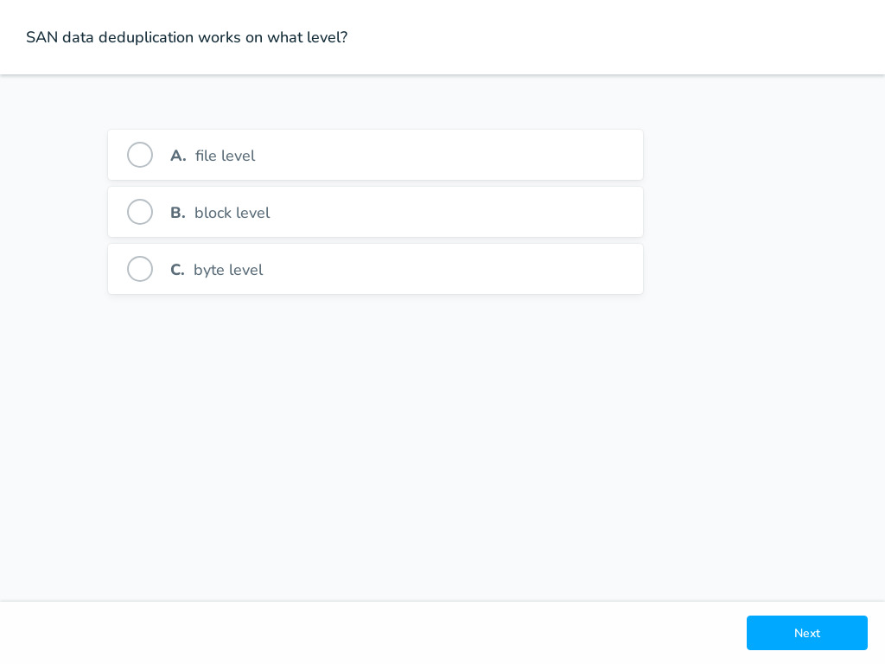

Slide 34
How Data Deduplication Works
Data is analyzed to identify duplicate files, blocks, or bytes across the entire storage system.
Unique data chunks are stored only once, with subsequent duplicates replaced by pointers or references to the stored chunk.
Block-level deduplication is particularly effective, as it breaks down files into smaller fixed-size or variable-size blocks, achieving a higher deduplication ratio by finding redundancies within and across files.

Slide 35
Maximizing Storage with Data Deduplication
Space Saving: Significant reduction in storage requirements by eliminating redundant data.
Cost Efficiency: Lower storage costs due to reduced space needs. Additionally, reduced data footprint leads to lower backup storage costs and shorter backup windows.
Network Efficiency: In environments where data is replicated or backed up over the network, deduplication reduces the amount of data that needs to be transferred, saving bandwidth and time.

Slide 36
Implementing Data Deduplication: Best Practices
Data deduplication can be implemented in various ways, either at the source (before data is written to disk) or at the target (after data is written to disk).
It's crucial to understand the data types and access patterns in your environment, as deduplication is more effective with certain data types (like backup data) than others (like multimedia files).
Regular monitoring and management of deduplication processes are essential to ensure that they operate efficiently and do not adversely impact system performance.

Slide 37
Replication in SANs: Ensuring Data Availability
Replication is a process of copying and maintaining data in multiple storage locations in a SAN environment, ensuring data availability and business continuity.
A key component in disaster recovery strategies, replication provides real-time or near-real-time duplication of data across storage systems.
Operates by tracking and copying changes (deltas) to ensure that replicas are consistent with the source.

Slide 38
Deltas and Blocks: The Heart of Replication
Deltas: Refers to the changes or differences between one set of data and another. In replication, only deltas (changed blocks) are transferred after the initial full copy, making the process bandwidth-efficient.
Blocks: The smallest unit of data in SANs. Replication processes often operate at the block level, ensuring precise and efficient copying of data.

Slide 39
Sync vs. Async: Balancing Speed and Safety
Synchronous Replication: Ensures that data is written to both primary and secondary locations simultaneously. Guarantees zero data loss, but requires higher bandwidth and can impact write performance due to the wait for acknowledgment from the remote site.
Asynchronous Replication: Data is first written to the primary location, and then the changes are replicated to the secondary site. This method introduces a slight delay, allowing for better write performance but at the risk of potential data loss if the primary site fails before data is replicated.

Slide 40
Best Practices for Replication in SANs
Choose between synchronous or asynchronous replication based on your organization's Recovery Point Objective (RPO) and Recovery Time Objective (RTO).
Monitor replication processes closely to ensure that data is being replicated accurately and efficiently, without unduly impacting system performance.
Regularly test failover to the secondary site to ensure that your replication strategy is effective and that your system can recover quickly in the event of a failure.

Slide 41
Tiered Storage: Tailoring SANs for Efficiency
Tiered storage in SANs categorizes data into different storage classes or 'tiers', such as high-performance SSDs in Tier 1 and more cost-effective HDDs in Tier 2.
Each tier in a SAN is characterized by its performance and cost, with Tier 1 offering the highest performance at a higher cost, and subsequent tiers offering reduced performance at lower costs.
The strategy aims to align the performance and cost characteristics of each tier with the access frequency and importance of the data stored in it.

Slide 42
How Tiered Storage Works in SANs
SANs utilize automated tiering to manage data placement efficiently. The system continuously monitors data access patterns to identify 'hot' (frequently accessed) and 'cold' (infrequently accessed) data.
Hot data is automatically migrated to higher tiers (SSDs) to facilitate quick access, while cold data is moved to lower tiers (HDDs) to optimize storage costs.
This dynamic process ensures data storage is always optimized for both performance and cost-effectiveness.

Slide 43
Optimizing SANs with Tiered Storage
Tiered storage dramatically enhances performance by ensuring that hot data is readily accessible on high-speed storage tiers.
Concurrently, it reduces overall storage costs by relegating cold data to more economical storage tiers.
Intelligent SAN management tools are essential to manage this complex process, automating data movement based on real-time access patterns and predefined policies.

Slide 44
RAID Levels in Tiered Storage: A Strategic Approach
In tiered storage within SANs, different RAID levels can be applied to different tiers to optimize both performance and data redundancy.
Higher tiers (e.g., Tier 1), typically composed of faster storage like SSDs, might use RAID levels that prioritize performance, such as RAID 0 (striping) or RAID 10 (striping + mirroring), to enhance read/write speeds.
Lower tiers (e.g., Tier 2), generally consisting of slower, higher-capacity storage like HDDs, might use RAID levels that provide greater redundancy and capacity, such as RAID 5 (striping with parity) or RAID 6 (striping with double parity), ensuring data protection and cost efficiency.

Slide 45
Optimizing Each Tier: RAID Considerations
The choice of RAID level for each tier should align with the tier’s purpose and the type of data it stores.
For tiers holding critical, frequently accessed data (Tier 1), RAID levels that offer high performance and fault tolerance (like RAID 10) are preferred.
For tiers designed for less critical, infrequently accessed data (Tier 2 and beyond), RAID levels that offer a balance between capacity, fault tolerance, and performance (like RAID 5 or RAID 6) are commonly used.

Slide 46
Implementing RAID Across Tiers
Implementing different RAID levels across tiers requires careful planning and an understanding of the organization's data access patterns, performance requirements, and redundancy needs.
It's crucial to monitor the performance and redundancy of each tier continuously to ensure that the chosen RAID level aligns with the tier's function and the organization’s overall storage strategy.
Regularly review and adjust RAID configurations as needed based on changing data requirements, technology advancements, or shifts in organizational priorities.

Slide 47
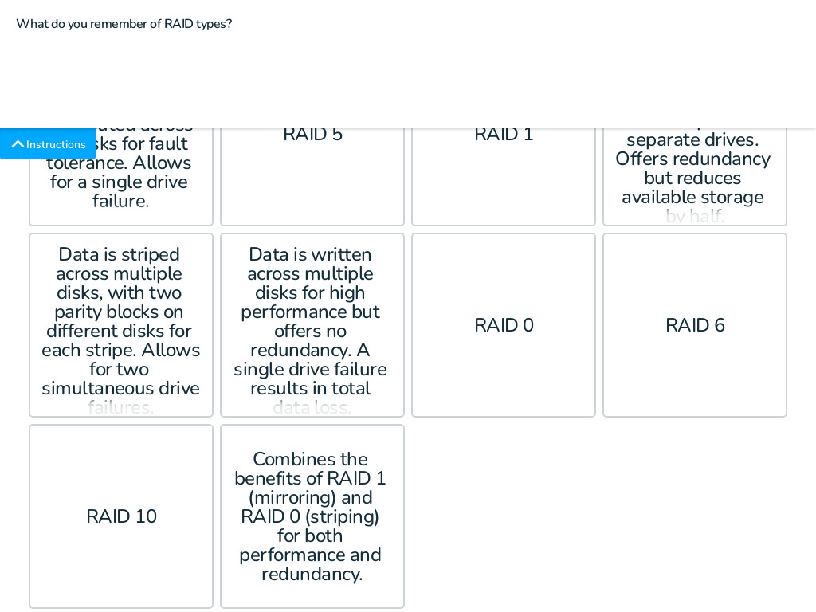

Slide 48
Storage Interfaces: SATA, SCSI, and SAS
SATA (Serial ATA): A common interface used in consumer devices. It's cost-effective but offers lower performance compared to SCSI and SAS. Not typically recommended for high-performance SAN environments due to slower data transfer rates and less robust error recovery features.
SCSI (Small Computer System Interface): Historically used in servers and workstations. Offers better performance than SATA but has been largely superseded by SAS in modern systems.
SAS (Serial Attached SCSI): Combines the best features of SCSI and SATA. It provides higher speed, dual-port connections for redundancy, and is more reliable for use in SANs. It's the preferred choice for enterprise environments where performance and reliability are critical.

Slide 49
How Interfaces Affect SAN Performance
Data Loss and Caching: SAS offers advanced error correction and detection mechanisms, reducing the risk of data loss. It supports extensive caching features, ensuring data integrity even during unexpected power losses or system crashes.
Longevity and Purpose in SANs: SAS drives are designed for continuous operation in demanding environments. They are built to handle a higher number of read/write cycles, making them ideal for SANs where longevity and consistent performance are paramount.

Slide 50
SSD Types: SLC vs. MLC
SLC (Single-Level Cell): Stores one bit per cell, offering faster write speeds, higher cell endurance, and lower power consumption. However, SLC SSDs are more expensive and typically have smaller storage capacities.
MLC (Multi-Level Cell): Stores multiple bits per cell, allowing for larger storage capacity at a lower cost. However, MLC SSDs have slower write speeds and a lower lifespan due to the higher wear and tear from storing more bits per cell.

Slide 51
The Challenge with MLC SSDs in SANs
MLC SSDs are not typically used in SAN environments due to their lower endurance and slower write speeds compared to SLC SSDs.
The intensive read/write cycles and the need for high reliability and performance in SANs make SLC SSDs a more suitable choice.
The potential for faster wear-out and data integrity issues under heavy use make MLC SSDs less ideal for the high-demand environment of a SAN.

Slide 52
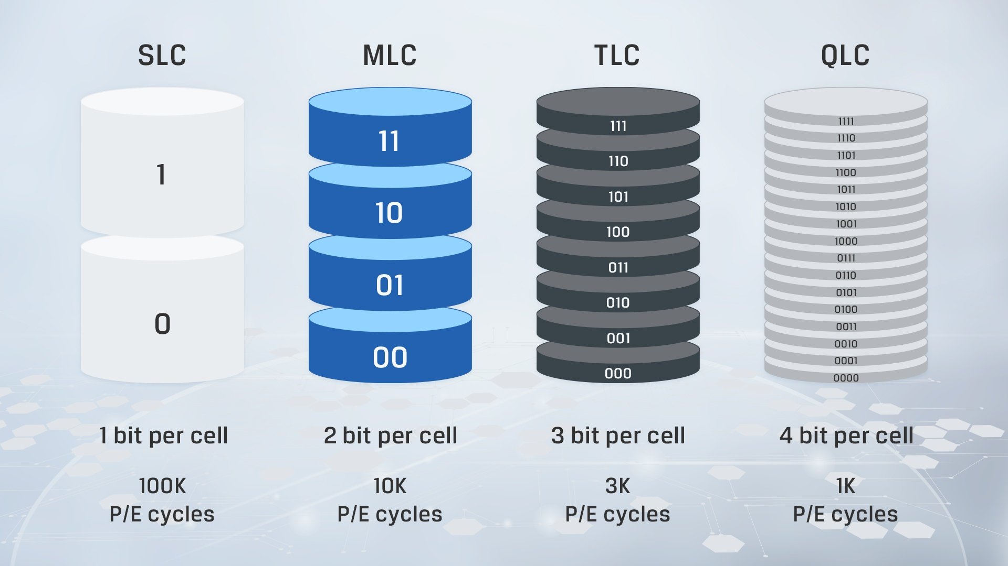
Charge levels per cell
Source: Kingston

Slide 53
NAND Flash Basics
Types of NAND
SLC – Single-Level Cell (1 bit/cell)
MLC – Multi-Level Cell (2 bits/cell)
TLC – Triple-Level Cell (3 bits/cell)
QLC – Quad-Level Cell (4 bits/cell)
Production Reality
TLC is now the baseline (most commonly produced).
QLC is the lowest cost (and lowest endurance).
SLC and MLC aren’t mass-produced anymore, but the concepts live on in “pseudo” modes.
Endurance vs. Capacity
More bits per cell = Higher capacity but Lower endurance.
Fewer bits per cell = Lower capacity but Higher endurance.

Slide 54
pSLC & pMLC (Pseudo Modes)
pSLC (Pseudo-SLC)
Treats TLC cells as if they were SLC (1 bit/cell).
Uses only 2 charge levels (0 or 1).
Boosts endurance & speed—fewer voltage states mean less wear and faster writes.
Trade-off: You lose ~⅔ of the capacity (using 1 bit instead of 3).
pMLC (Pseudo-MLC)
Also uses TLC but stores 2 bits/cell.
Strikes a balance between speed/endurance and capacity.
Trade-off: Less capacity reduction than pSLC, but still higher endurance than regular TLC.
Why Do This?
Critical workloads (e.g., caching, logging, high-write databases) need higher endurance.
pSLC/pMLC ensures longer lifespan and faster writes at the expense of capacity.

Slide 55
Why More Bits Wear Out Cells Faster
Voltage Levels
Each additional bit doubles the number of voltage states needed.
Example: TLC requires 8 distinct voltage states, QLC needs 16.
Tighter voltage tolerances = more stress on each cell.
Write Amplification
More complex state programming = increased wear per write/erase cycle.
Cells degrade faster, reducing total program/erase (P/E) cycles.
pSLC Advantage
Only 2 voltage states → simpler, quicker, less stress.
Fewer errors, less error correction overhead, and longer component life.

Slide 56
Write Policies in SANs: Write Back vs. Write Through
Write Through: Every write operation is written directly to the storage media and confirmed before the next operation. It ensures data integrity but can lead to slower write performance as each write requires acknowledgment from the storage media.
Write Back (Write Behind): Write operations are first written to a fast cache and then written to the storage media at a later time. This allows for faster write performance as operations don't have to wait for storage media acknowledgment. However, it introduces the risk of data loss if the cache is not properly protected.

Slide 57
Leveraging Cache for Performance in SANs
The cache in a SAN environment temporarily stores data for quick access. It plays a critical role in both write back and write through policies.
Write Through: The cache improves read performance but doesn't impact write performance significantly.
Write Back: The cache significantly enhances write performance but requires robust protection to ensure data integrity.

Slide 58
Protecting Data with Battery Backup in SANs
Battery backup units (BBUs) or supercapacitors are essential in SANs, especially when using write-back cache policies.
They ensure that data in the cache can be written to permanent storage in the event of a power failure, preventing data loss.
BBUs provide power to the SAN long enough for all data in the cache to be safely transferred to non-volatile storage, such as SSDs or HDDs.

Slide 59
Cache Destinations: Memory vs. SSD
Cache to Memory: Offers extremely fast data access but is volatile. In the event of power loss, data in memory can be lost unless a battery backup is in place.
Cache to SSD: SSDs, being non-volatile, offer a safer option for caching data. While not as fast as memory, modern SSDs provide high-speed access and ensure data is not lost if power is unexpectedly cut.
The choice between memory and SSD for caching should be based on the balance between performance needs and data safety requirements.

